Slide 1
Transnational training for youthworkers and educators
Rural Entrepreneurship, Active Citizenship and Territories Identity Visibility through the Engagement of Youth
Project Number 2022-1-ES02-KA220-YOU-000086121

Slide 2
Technical details
When? 22/01/2024 to 26/01/2024 (1 travel day + 3 working days + 1 working day).
Where? Brežice, Slovenia.
Who? 14 youth workers, educators and project partners representatives from Spain, Austria, Italy, Greece, Slovenia and Portugal.
Why? The main objective of this training course will be to explore the toolkit for professionals and educators working with youth in rural areas that it is being developed within the project. Participants will be able to go deeper into this material thanks to activities that will train them on promoting youth engagement in rural areas, raising youth awareness and identity in relation to their regions, and foster youth potential towards their communities development and promotion.
How much? The costs related to travels, lodging, materials, etc. will be covered by the project.

Slide 3
Definition of the activities
Participants will participate on workshops based on non-formal methods that will allow them to:
Getting to know the project and is partners.
Taking part on networking activities with their peers to exchange good practices and generate synergies.
Discovering the research about youth participation developed on the project regions and the policy brief created out of its results.
Exploring the toolkit for youth workers of the project and learning how to implement workshops for youth based on non-formal education for the cocreation of youth initiatives in their areas to contribute to the project testing of materials.
Being involved on the design of the next project activities and products while are trained on using the monitoring tools of Reactive Youth.

Slide 4
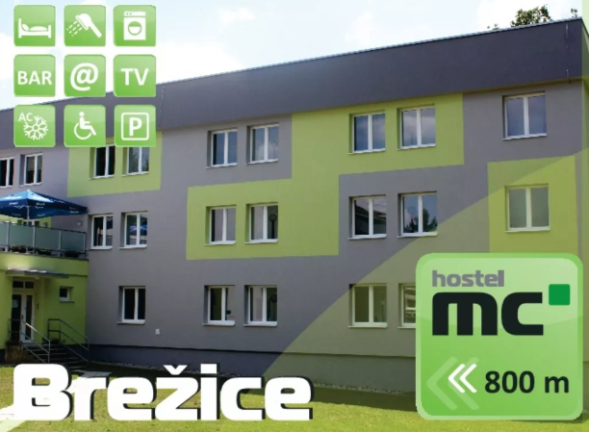
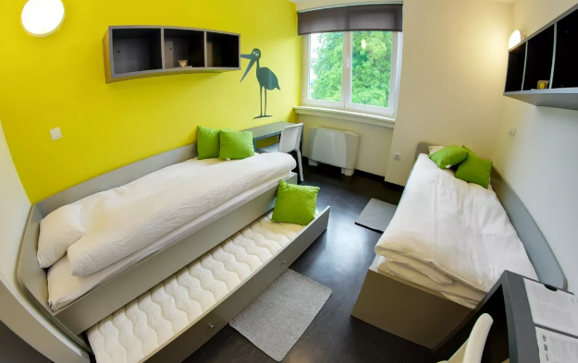
Lodging and accommodation
Participants will be accommodated in Hostel Brežice (Gubčeva ulica 10a, 8250 Brežice). More information about the accommodation can be found here:
https://www.mc-hostel.si/informacije
https://www.youth-hostel.si/en/hostels/youth-hostel-mc-brezice
Activities will be executed in spaces of Hostel Brežice or Youth centre Brežice.
More information about the lodging conditions, rooms distribution and meals will be sent to participants previously to the mobility.

Slide 5
Rural Entrepreneurship, Active Citizenship and Territories Identity Visibility through the Engagement of Youth
Project Number 2022-1-ES02-KA220-YOU-000086121
The European Commission's support for the production of this publication does not constitute an endorsement of the contents, which reflect the views only of the authors, and the Commission cannot be held responsible for any use which may be made of the information contained therein.

